Slide 1
Welcome to Year 3!
Nelson Class

Slide 2
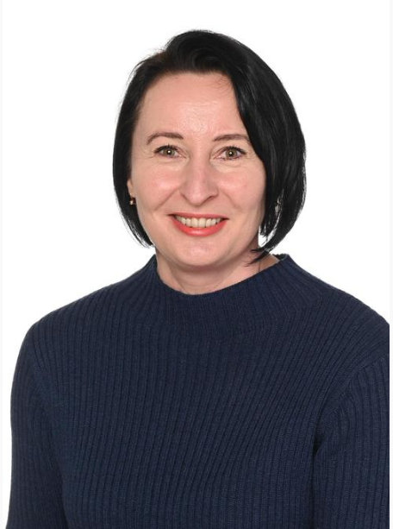
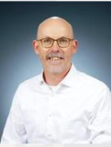
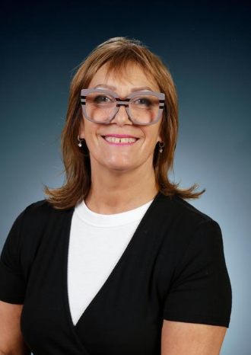
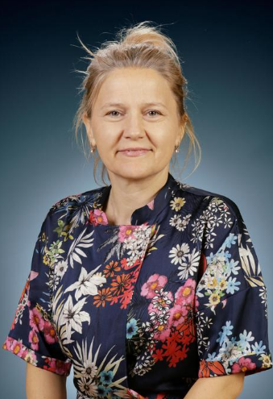
Who’s teaching your child…
Mrs Brown
Teacher
Mr Bradley
Headteacher
Mrs Murphy
Teaching Assistant
Miss Aga
LSA
Mme Douglas - French
MSSP - Sports coach Music – Music MMF

Slide 3







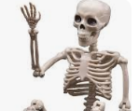
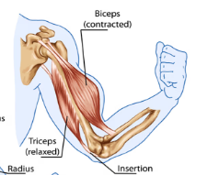
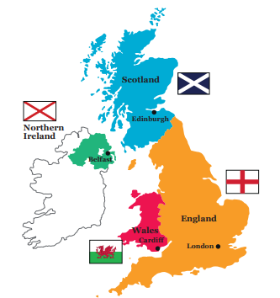
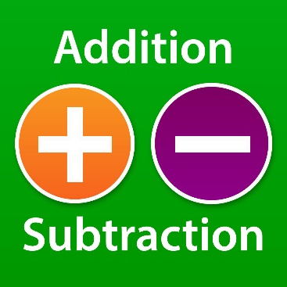
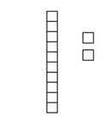
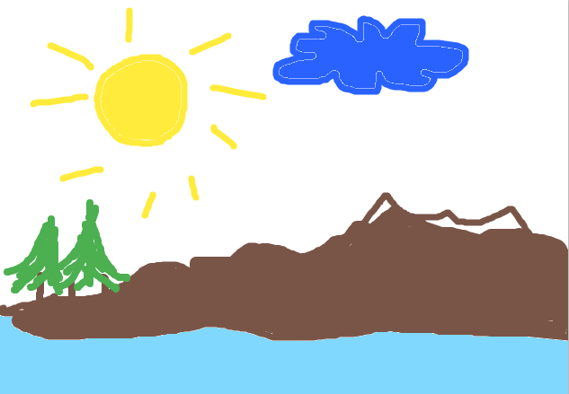
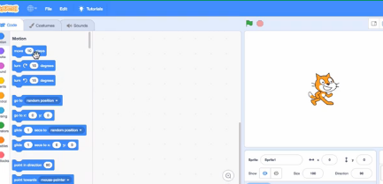

PSHE
The Zones of Regulation
English - writing
Guided reading
Skeletons, muscles and nutrition will be taught in Biology, and Rocks in Chemistry
Science
Geography
How regions vary in the UK
Skeletons, muscles and nutrition will be taught in Biology, and Rocks in Chemistry
Maths
RE
Respectful religion and worldviews
Place Value to 1000, Addition and Subtraction, and Multiplication and Division
ICT
Digital painting Paintz and Scratch

Slide 4
Routines
Doors open at 8:45am
Doors close at 8:53
Registration is at 8:55 prompt, all children need to be seated by this time.
Any children arriving after this time must go to the office to register.
School finishes at 3.30pm.
Children who have not been collected by 3.40pm will be taken to the ‘After School Club’.
A charge will be applied for any late pick up.

Slide 5
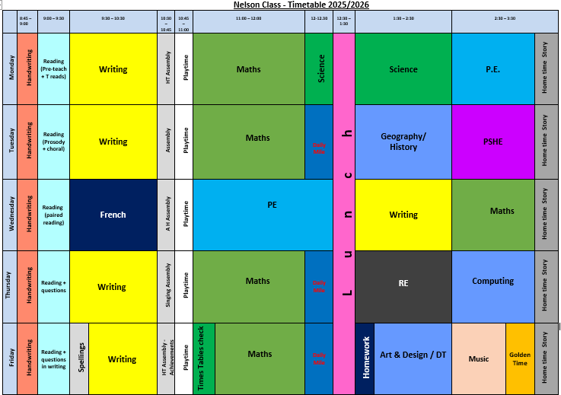
Timetable

Slide 6

PE
P.E. sessions for Nelson class are on Monday and Wednesday.
Please ensure your child comes to school on these days wearing the correct P.E. kit, which they will be wearing for the whole day.
This must include a change of trainers or plimsolls, as P.E. lessons will be taught outside whenever possible.
An item of clothing with the school logo must be worn when coming to and from school, such as a school jumper or cardigan.

Slide 7
PE kit
Every child will need:
A PE t-shirt - navy blue
Navy blue shorts
Plimsolls for indoor* PE
*Trainers and dark plain tracksuit bottoms can be worn in the winter for outdoor P.E.

Slide 8

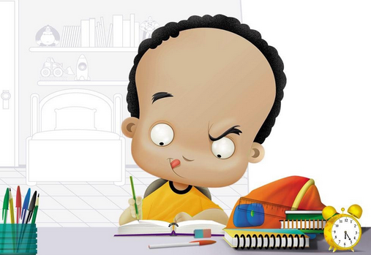
Homework
Homework is given to the children on a Friday and is to be returned on Wednesday.
It is linked to the children’s learning that week.

Slide 9

Spelling
Starting soon, spelling will be given to the children on a Friday.
They should practise their spelling each evening ready for a spelling test on a Friday.

Slide 10

Reading
Children are expected to read each night. Please record the book title, page numbers read and a comment about your child’s reading.
Children should bring their reading records in daily.

Slide 11
Recommended books for Y3

Slide 12
Assessments – tests
Maths - end of each term
Writing – Independent writing assessments – end of each term
Reading, Grammar and Spelling – end of each term

Slide 13
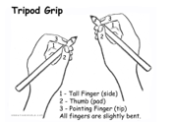
Handwriting
Handwriting
Handwriting is a very important part of our curriculum.

Slide 14

Our School Website
Additional resources are available on the school website.
https://www.mertonabbey.merton.sch.uk/class-pages/
Wondering how to access them?
Please go to the school website and click on ‘Children’ and then on ‘Class Pages’. From there, click on ‘Nelson Class’ and then on any icon you might be interested in’
Have a look and enjoy the latest news from Nelson class.

Slide 15


Slide 16

Expectations!
We want all children to achieve well.
Children are challenged to meet their full potential.
Mild Hot Spicy

Slide 17

Any Questions?

Slide 18

Thank you for your support!
Mrs Brown

