Slide 1

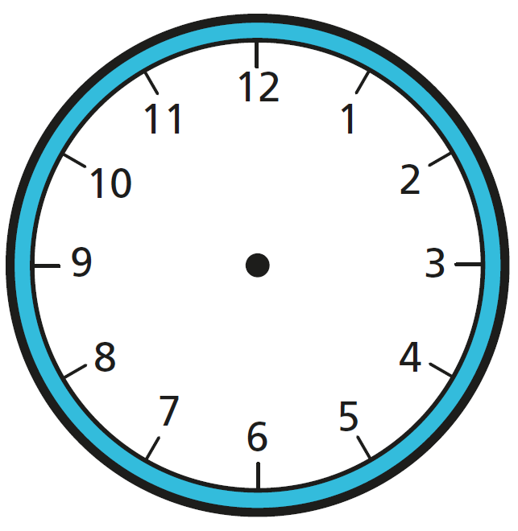
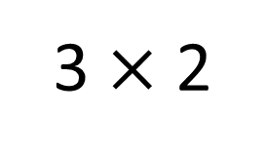
Year 3 | Week 1 | Day 1
3 $×$ 2
1) How many tens are there in 67?
2) How many minutes are there in 1 hour?
3) Write the time shown on the clock.
4) Add 12 and 27 together.

Slide 2
Year 3 | Week 1 | Day 1
3 $×$ 2
1) How many tens are there in 67?
2) How many minutes are there in 1 hour?
3) Write the time shown on the clock.
4) Add 12 and 27 together.
6 tens
60 minutes
8 o’clock
39

Slide 3
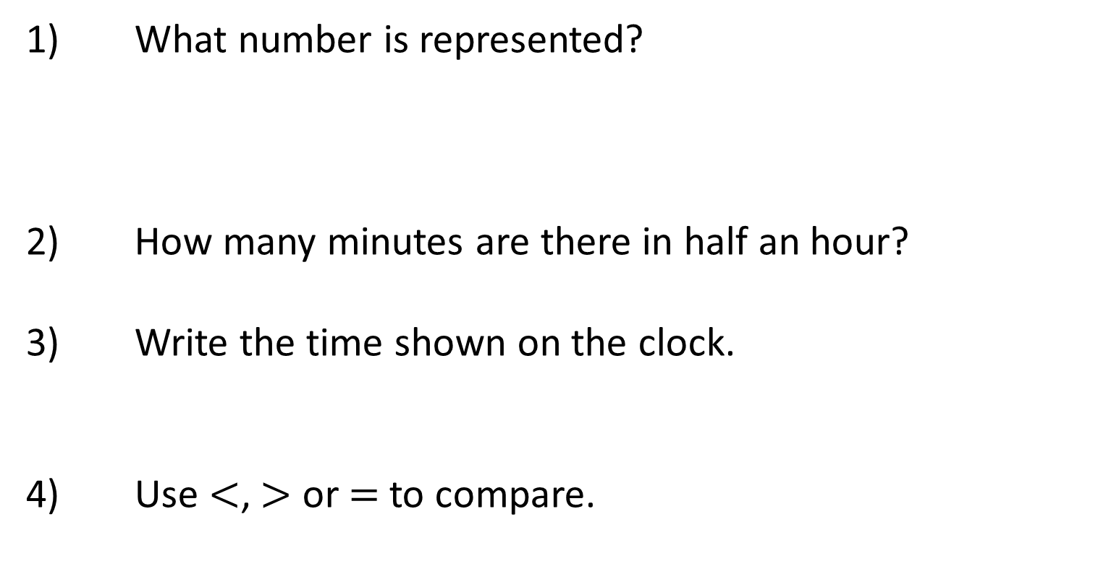
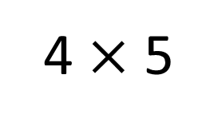
Year 3 | Week 1 | Day 2
4 $×$ 5
1) What number is represented?
2) How many minutes are there in half an hour?
3) Write the time shown on the clock.
4) Use $<$, $>$ or $=$ to compare.
3 g 3 kg

Slide 4

Year 3 | Week 1 | Day 2
4 $×$ 5
1) What number is represented?
2) How many minutes are there in half an hour?
3) Write the time shown on the clock.
4) Use $<$, $>$ or $=$ to compare.
28
30 minutes
quarter past 7
$$<$$
3 g 3 kg

Slide 5
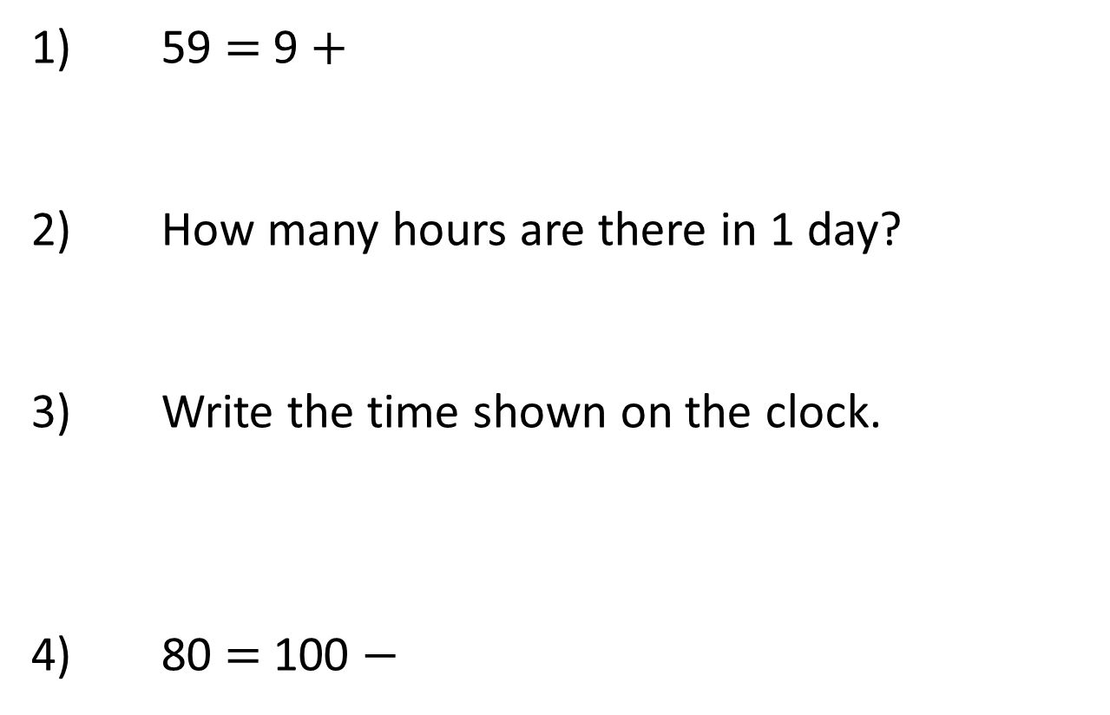
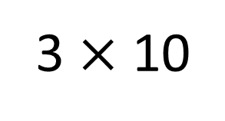
Year 3 | Week 1 | Day 3
3 $×$ 10
1) 59 $=$ 9 $+$
2) How many hours are there in 1 day?
3) Write the time shown on the clock.
4) 80 $=$ 100 $−$

Slide 6
Year 3 | Week 1 | Day 3
3 $×$ 10
1) 59 $=$ 9 $+$
2) How many hours are there in 1 day?
3) Write the time shown on the clock.
4) 80 $=$ 100 $−$
50
24 hours
quarter to 5
20

Slide 7
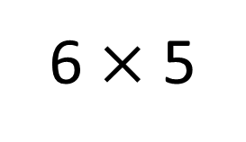
Year 3 | Week 1 | Day 4
6 $×$ 5
1) What number is the arrow pointing to?
2) How many days are there in 1 week?
3) Write the time shown on the clock.
4) Double 7
0
50

Slide 8
Year 3 | Week 1 | Day 4
6 $×$ 5
1) What number is the arrow pointing to?
2) How many days are there in 1 week?
3) Write the time shown on the clock.
4) Double 7
0
15
50
7 days
half past 10
14

Slide 9

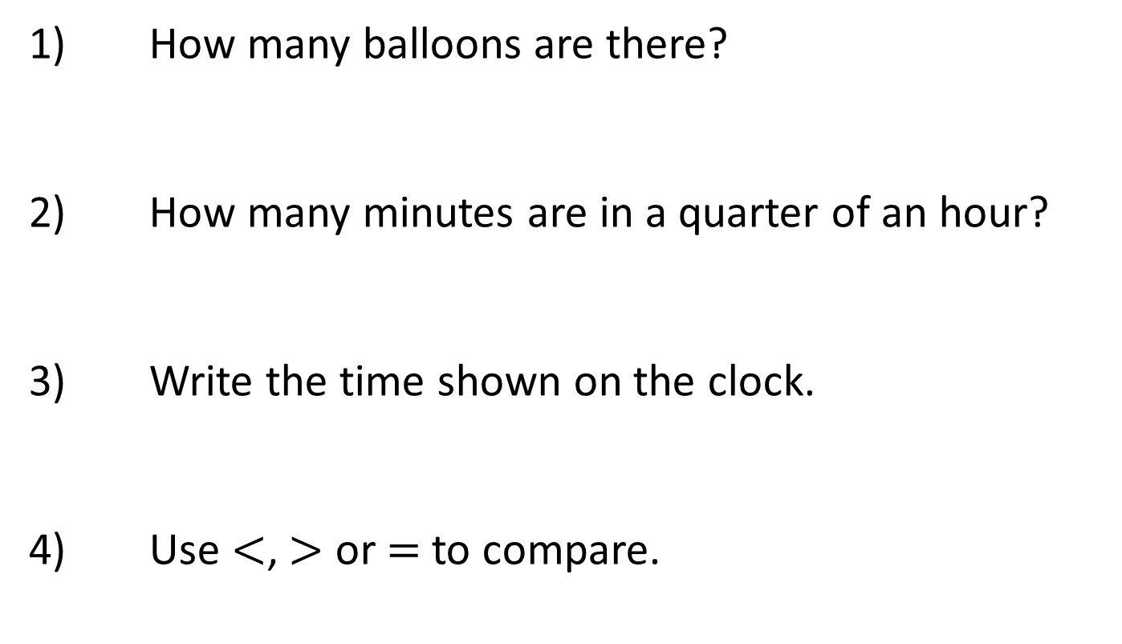
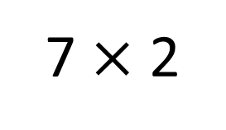
Year 3 | Week 1 | Day 5
7 $×$ 2
1) How many balloons are there?
2) How many minutes are in a quarter of an hour?
3) Write the time shown on the clock.
4) Use $<$, $>$ or $=$ to compare.
One metre 1 centimetre

Slide 10

Year 3 | Week 1 | Day 5
7 $×$ 2
1) How many balloons are there?
2) How many minutes are in a quarter of an hour?
3) Write the time shown on the clock.
4) Use $<$, $>$ or $=$ to compare.
700
15 minutes
20 past 1
One metre 1 centimetre
$$>$$

Slide 11

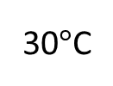
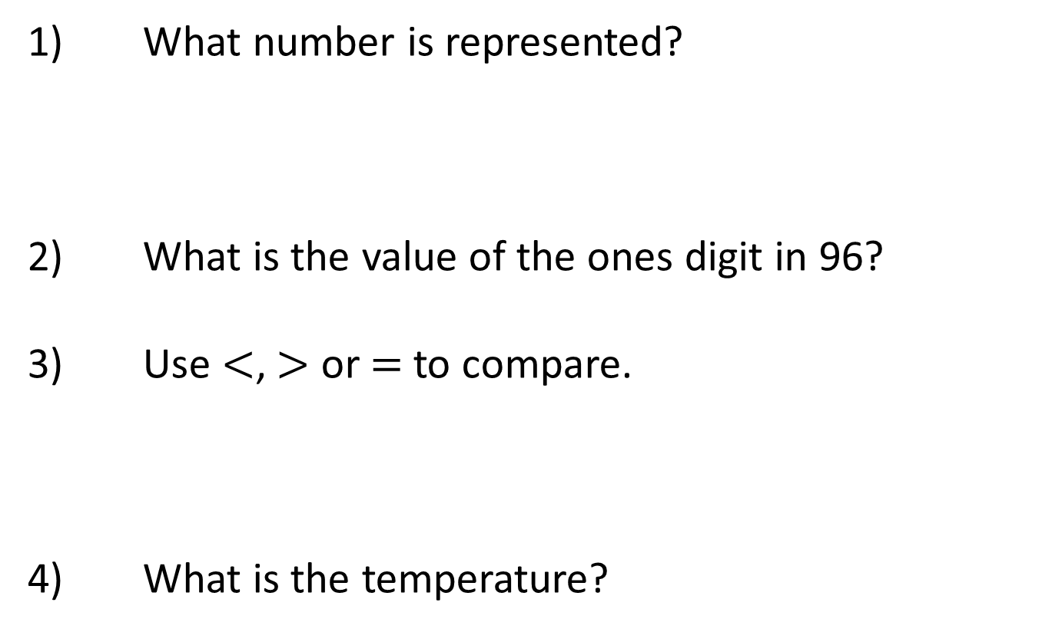
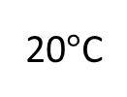
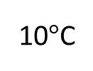
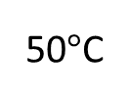
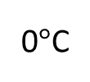
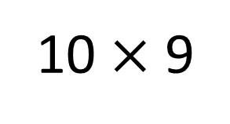
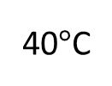
Year 3 | Week 2 | Day 1
10 $×$ 9
1) What number is represented?
2) What is the value of the ones digit in 96?
3) Use $<$, $>$ or $=$ to compare.
4) What is the temperature?
1 hour 8 minutes 70 minutes
0$°$C
10$°$C
20$°$C
30$°$C
40$°$C
50$°$C

Slide 12

Year 3 | Week 2 | Day 1
10 $×$ 9
1) What number is represented?
2) What is the value of the ones digit in 96?
3) Use $<$, $>$ or $=$ to compare.
4) What is the temperature?
348
6
$$<$$
1 hour 8 minutes 70 minutes
0$°$C
10$°$C
20$°$C
30$°$C
40$°$C
50$°$C
25 °C

Slide 13



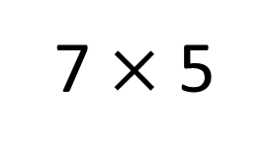
Year 3 | Week 2 | Day 2
7 $×$ 5
1) Complete the part-whole model.
2) What number is represented?
3) How many days are there in 2 weeks?
4) Subtract 31 from 57
751
700
1

Slide 14
Year 3 | Week 2 | Day 2
7 $×$ 5
1) Complete the part-whole model.
2) What number is represented?
3) How many days are there in 2 weeks?
4) Subtract 31 from 57
751
700
50
1
25
14
26

Slide 15
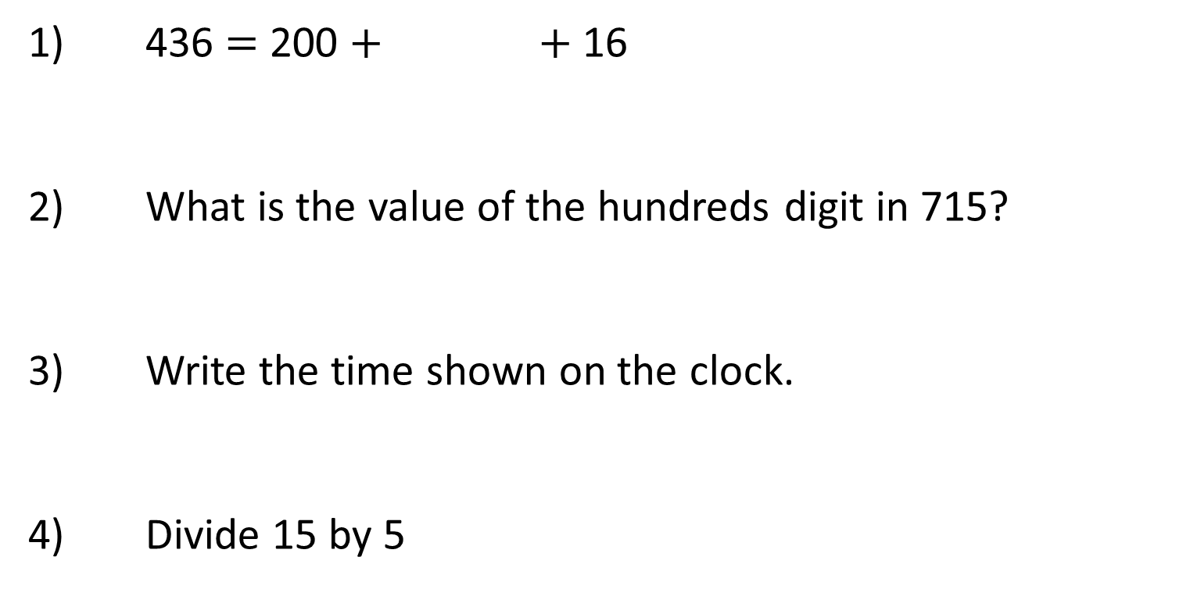
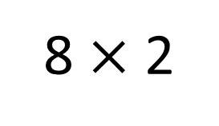
Year 3 | Week 2 | Day 3
8 $×$ 2
1) 436 $=$ 200 $+$ $+$ 16
2) What is the value of the hundreds digit in 715?
3) Write the time shown on the clock.
4) Divide 15 by 5

Slide 16
Year 3 | Week 2 | Day 3
8 $×$ 2
1) 436 $=$ 200 $+$ $+$ 16
2) What is the value of the hundreds digit in 715?
3) Write the time shown on the clock.
4) Divide 15 by 5
220
700
10 to 4
3

Slide 17

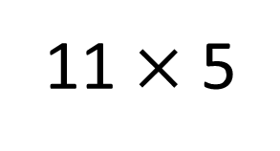
Year 3 | Week 2 | Day 4
11 $×$ 5
1) What number is represented?
2) Complete the number track.
3) Is this statement true or false?
There are 120 minutes in two hours.
4) Subtract 7 from 49
 |  | 400 | 300 | 200 | 100

Slide 18
Year 3 | Week 2 | Day 4
11 $×$ 5
1) What number is represented?
2) Complete the number track.
3) Is this statement true or false?
There are 120 minutes in two hours.
4) Subtract 7 from 49
423
 |  | 400 | 300 | 200 | 100
600
500
True
42

Slide 19
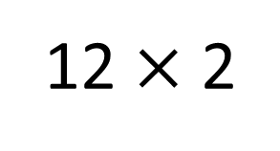
Year 3 | Week 2 | Day 5
12 $×$ 2
1) What number is the arrow pointing to?
2) 753 is made up 100s, 10s and 1s.
3) How many minutes are there in one and a half hours?
4) How many quarter-turns are there in a full turn?
200
400

Slide 20
Year 3 | Week 2 | Day 5
12 $×$ 2
1) What number is the arrow pointing to?
2) 753 is made up 100s, 10s and 1s.
3) How many minutes are there in one and a half hours?
4) How many quarter-turns are there in a full turn?
200
320
400
7
5
3
90
4

Slide 21
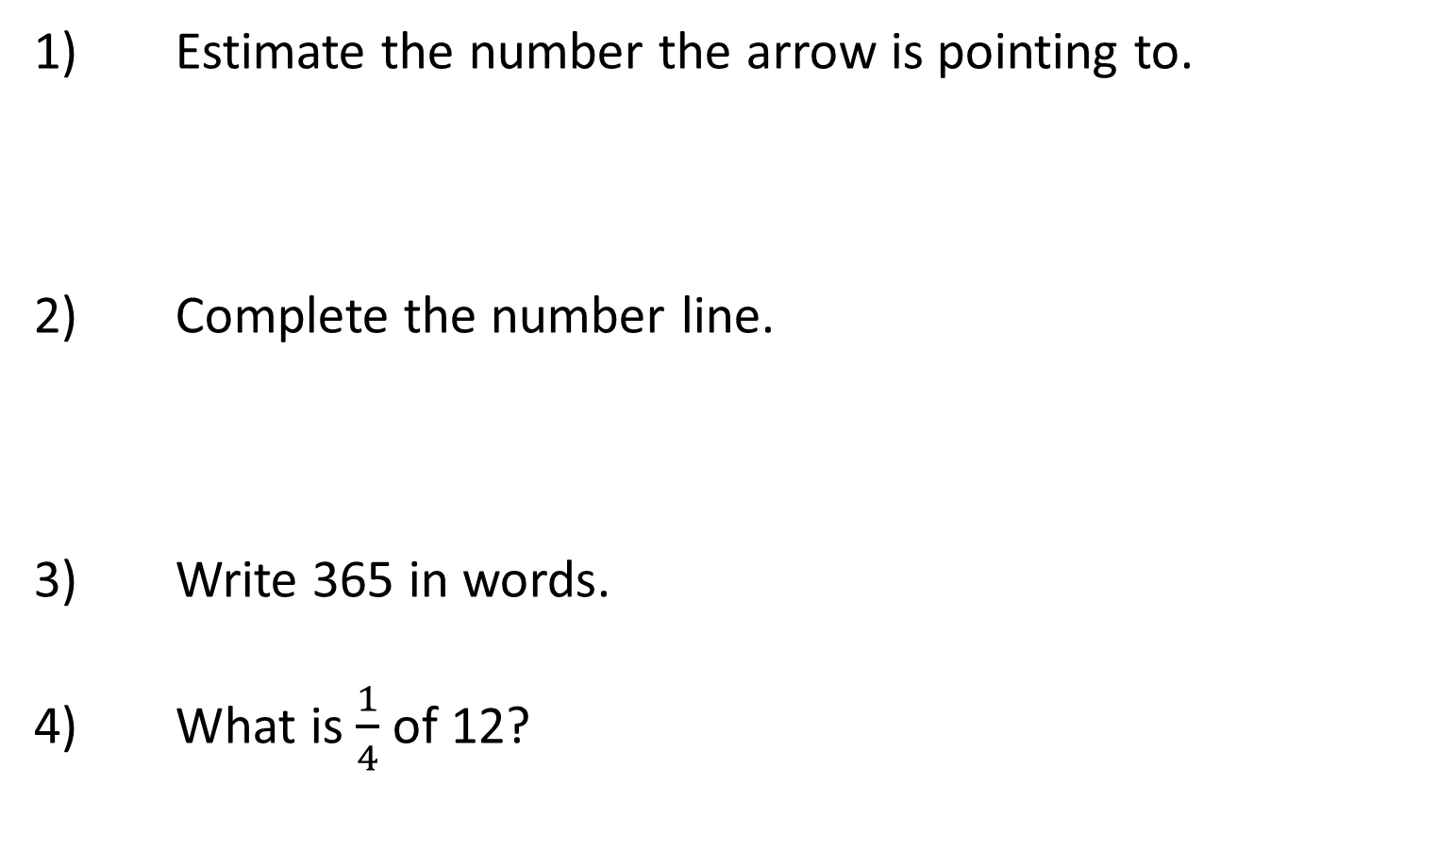
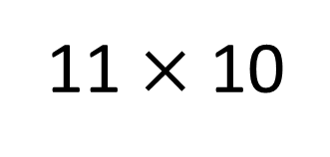
Year 3 | Week 3 | Day 1
11 $×$ 10
1) Estimate the number the arrow is pointing to.
2) Complete the number line.
3) Write 365 in words.
4) What is $\frac{1}{4}$ of 12?
0
100
200
300
400
500
0
1,000

Slide 22
Year 3 | Week 3 | Day 1
11 $×$ 10
1) Estimate the number the arrow is pointing to.
2) Complete the number line.
3) Write 365 in words.
4) What is $\frac{1}{4}$ of 12?
350
0
100
200
300
400
500
0
200
400
600
800
1,000
three hundred and sixty-five
3

Slide 23
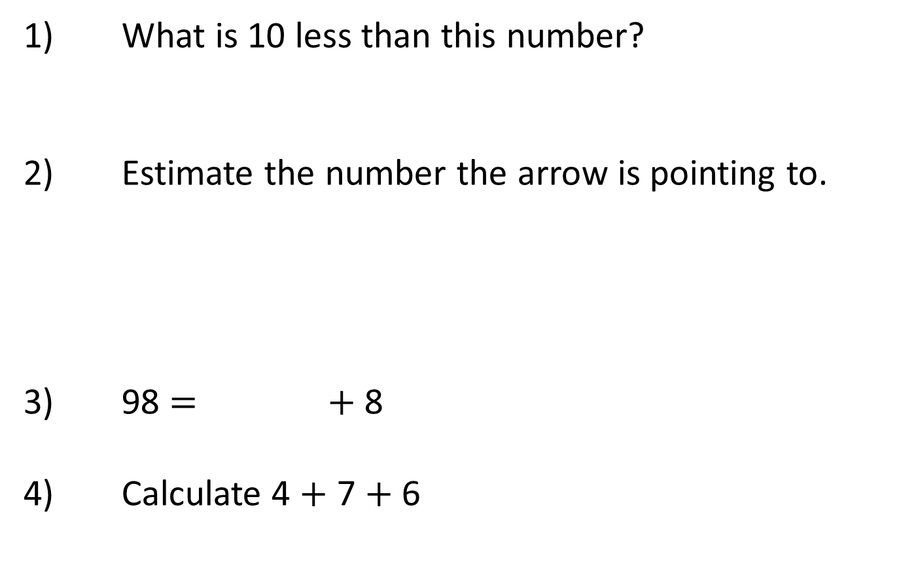
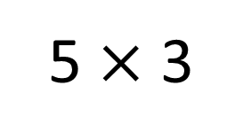
Year 3 | Week 3 | Day 2
5 $×$ 3
1) What is 10 less than this number?
2) Estimate the number the arrow is pointing to.
3) 98 $=$ $+$ 8
4) Calculate 4 $+$ 7 $+$ 6
100
110
120
130
140
150
160
170
180
190
200

Slide 24
Year 3 | Week 3 | Day 2
5 $×$ 3
332
1) What is 10 less than this number?
2) Estimate the number the arrow is pointing to.
3) 98 $=$ $+$ 8
4) Calculate 4 $+$ 7 $+$ 6
195
100
110
120
130
140
150
160
170
180
190
200
90
17

Slide 25
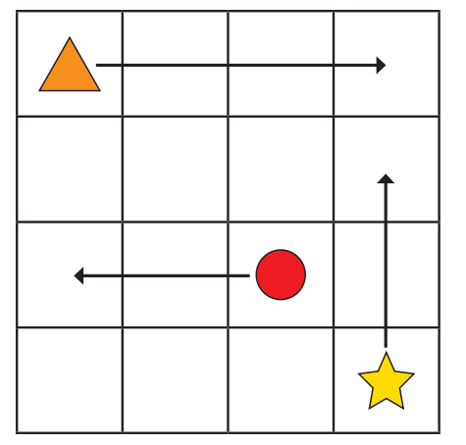
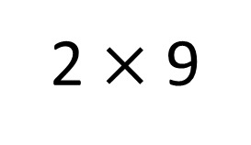
Year 3 | Week 3 | Day 3
2 $×$ 9
1) What is 100 less 176?
2) is 100 more than 508
3) There are tens in 100
4) The circle is moving squares .

Slide 26
Year 3 | Week 3 | Day 3
2 $×$ 9
1) What is 100 less 176?
2) is 100 more than 508
3) There are tens in 100
4) The circle is moving squares .
76
608
10
2
left

Slide 27
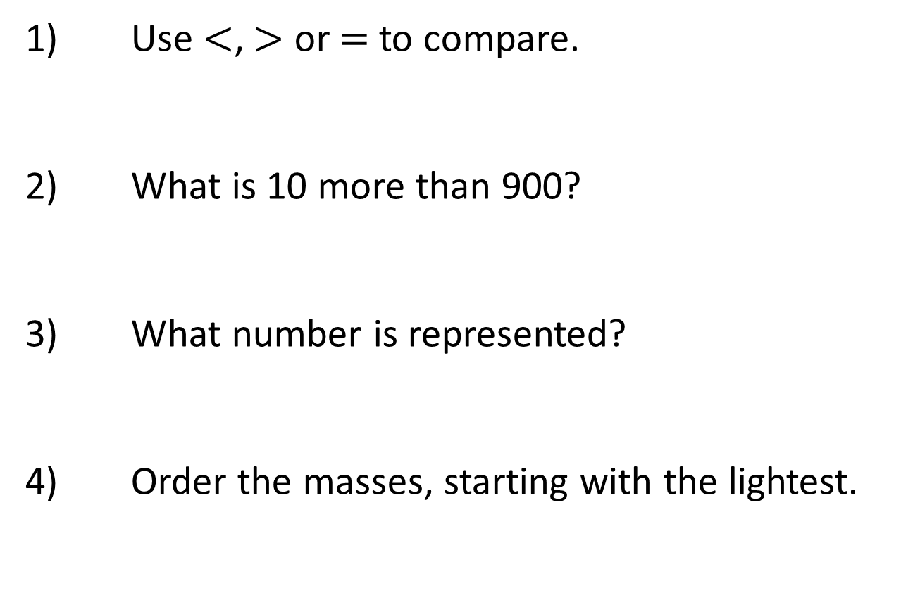
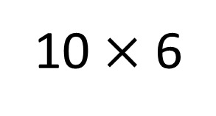
Year 3 | Week 3 | Day 4
10 $×$ 6
1) Use $<$, $>$ or $=$ to compare.
2) What is 10 more than 900?
3) What number is represented?
4) Order the masses, starting with the lightest.
472 427
15 g, 85 g, 37 g, 58 g

Slide 28

Year 3 | Week 3 | Day 4
10 $×$ 6
1) Use $<$, $>$ or $=$ to compare.
2) What is 10 more than 900?
3) What number is represented?
4) Order the masses, starting with the lightest.
$$>$$
472 427
910
232
15 g, 85 g, 37 g, 58 g
15 g, 37 g, 58 g, 85 g

Slide 29
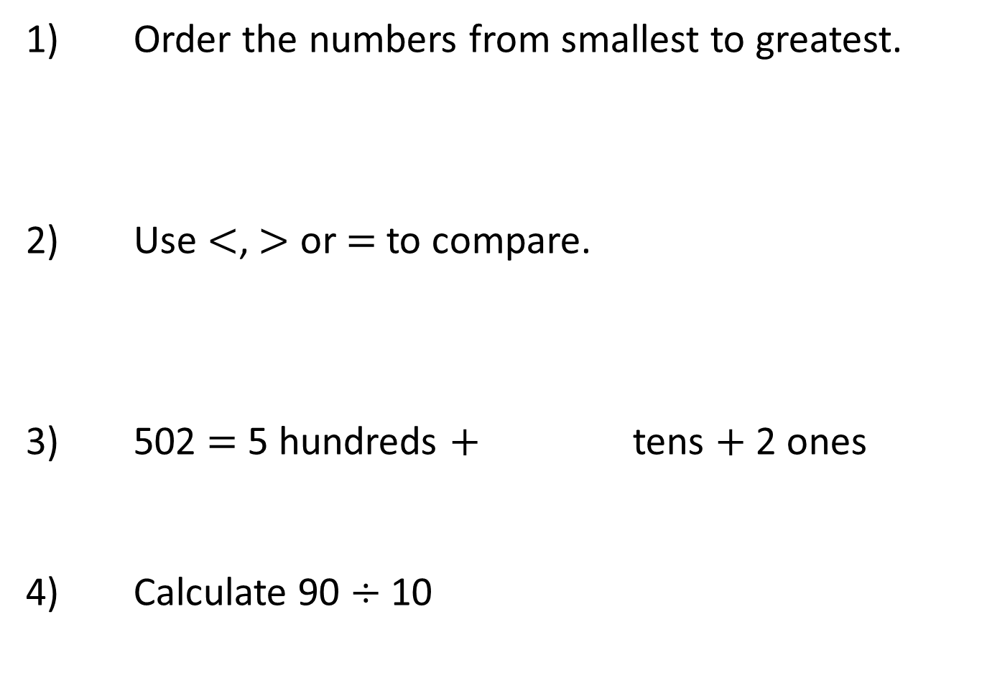
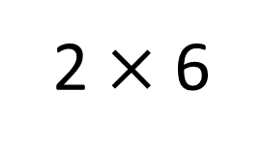
Year 3 | Week 3 | Day 5
2 $×$ 6
1) Order the numbers from smallest to greatest.
2) Use $<$, $>$ or $=$ to compare.
3) 502 $=$ 5 hundreds $+$ tens $+$ 2 ones
4) Calculate 90 $÷$ 10
390 , 387 , 393 , 389
3 hundreds and 7 ones 370

Slide 30

Year 3 | Week 3 | Day 5
2 $×$ 6
1) Order the numbers from smallest to greatest.
2) Use $<$, $>$ or $=$ to compare.
3) 502 $=$ 5 hundreds $+$ tens $+$ 2 ones
4) Calculate 90 $÷$ 10
390 , 387 , 393 , 389
387 , 389 , 390 , 393
3 hundreds and 7 ones 370
$$<$$
0
9

