Slide 1




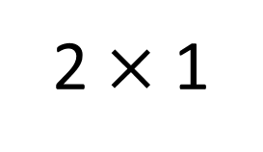
Year 3 | Week 4 | Day 1
2 $×$ 1
1) Complete the number track.
2) Estimate the number that the arrow is pointing to.
3) Write the number in numerals.
4) How many sides does a pentagon have?
 | 400 | 350 |  | 250 | 200
0
1,000

Slide 2
Year 3 | Week 4 | Day 1
2 $×$ 1
1) Complete the number track.
2) Estimate the number that the arrow is pointing to.
3) Write the number in numerals.
4) How many sides does a pentagon have?
 | 400 | 350 |  | 250 | 200
450
300
500
0
1,000
235
5

Slide 3
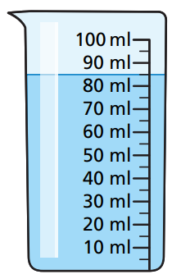
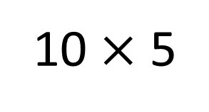
Year 3 | Week 4 | Day 2
10 $×$ 5
1) Complete the bar model.
2) 652 is less than 662
3) Write 382 in words.
4) How much water is in the beaker?
100
70

Slide 4
Year 3 | Week 4 | Day 2
10 $×$ 5
1) Complete the bar model.
2) 652 is less than 662
3) Write 382 in words.
4) How much water is in the beaker?
100
70
30
10
three hundred and eighty-two
85 ml

Slide 5
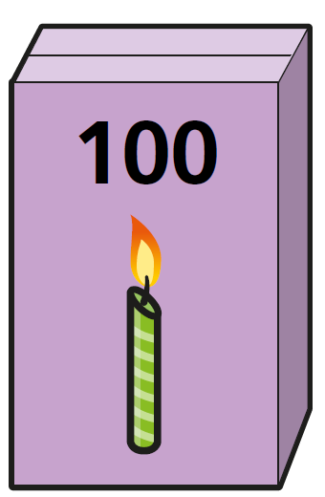
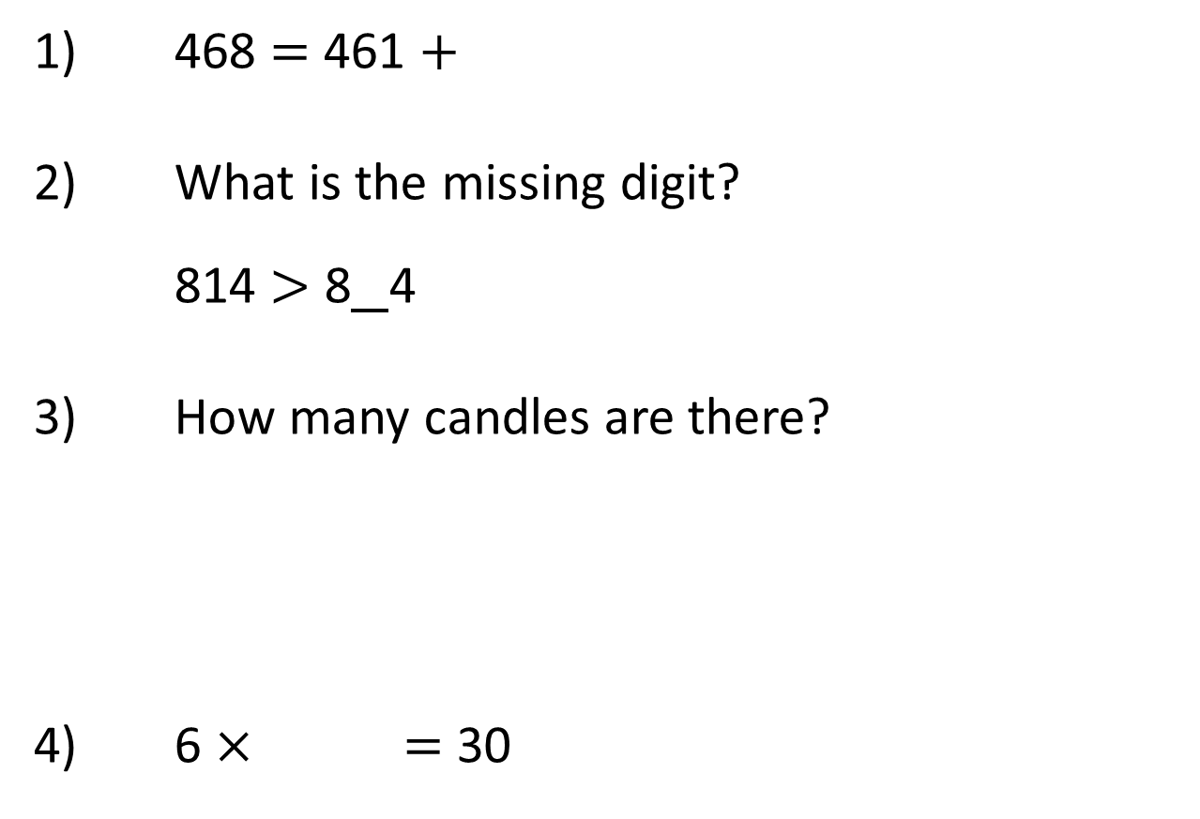
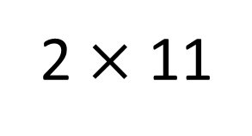
Year 3 | Week 4 | Day 3
2 $×$ 11
1) 468 $=$ 461 $+$
2) What is the missing digit?
814 $>$ 8 4
3) How many candles are there?
4) 6 $×$ $=$ 30

Slide 6
Year 3 | Week 4 | Day 3
2 $×$ 11
7
1) 468 $=$ 461 $+$
2) What is the missing digit?
814 $>$ 8 4
3) How many candles are there?
4) 6 $×$ $=$ 30
0
500
5

Slide 7
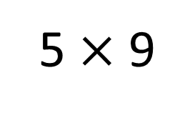
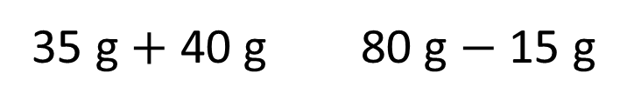
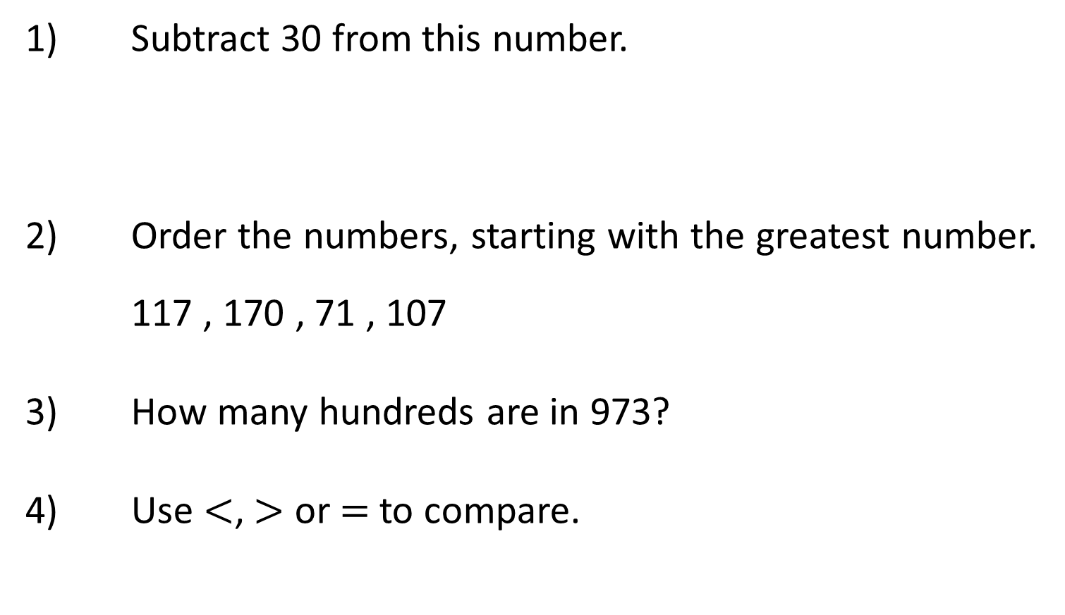
Year 3 | Week 4 | Day 4
5 $×$ 9
1) Subtract 30 from this number.
2) Order the numbers, starting with the greatest number.
117 , 170 , 71 , 107
3) How many hundreds are in 973?
4) Use $<$, $>$ or $=$ to compare.
Hundreds | Tens | Ones
35 g $+$ 40 g 80 g $−$ 15 g

Slide 8

Year 3 | Week 4 | Day 4
5 $×$ 9
1) Subtract 30 from this number.
2) Order the numbers, starting with the greatest number.
117 , 170 , 71 , 107
3) How many hundreds are in 973?
4) Use $<$, $>$ or $=$ to compare.
Hundreds | Tens | Ones
201
170 , 117 , 107 , 71
9 hundreds
$$>$$
35 g $+$ 40 g 80 g $−$ 15 g

Slide 9
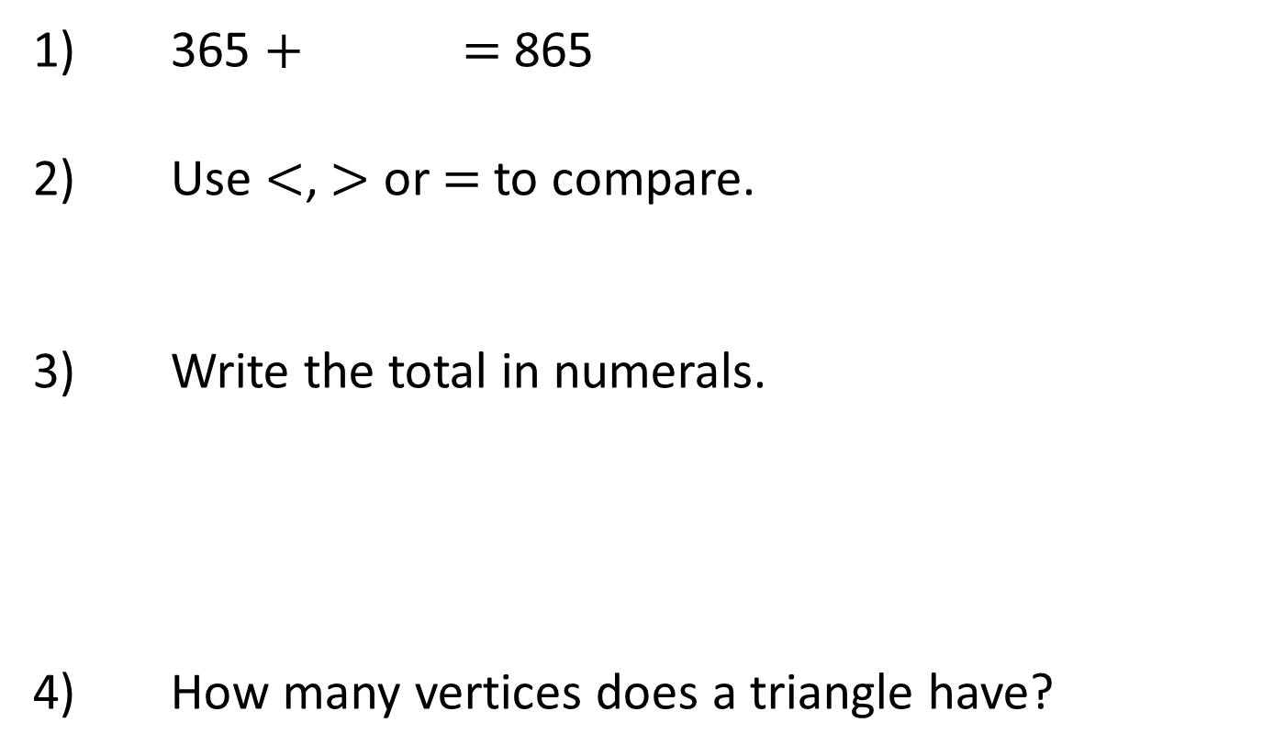
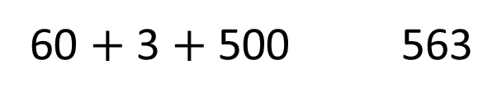


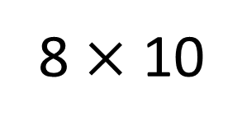

Year 3 | Week 4 | Day 5
8 $×$ 10
1) 365 $+$ $=$ 865
2) Use $<$, $>$ or $=$ to compare.
3) Write the total in numerals.
4) How many vertices does a triangle have?
60 $+$ 3 $+$ 500 563
$$+$$
$$+$$
$$=$$

Slide 10

Year 3 | Week 4 | Day 5
8 $×$ 10
1) 365 $+$ $=$ 865
2) Use $<$, $>$ or $=$ to compare.
3) Write the total in numerals.
4) How many vertices does a triangle have?
500
$$=$$
60 $+$ 3 $+$ 500 563
$$+$$
$$+$$
$$=$$
248
3

Slide 11

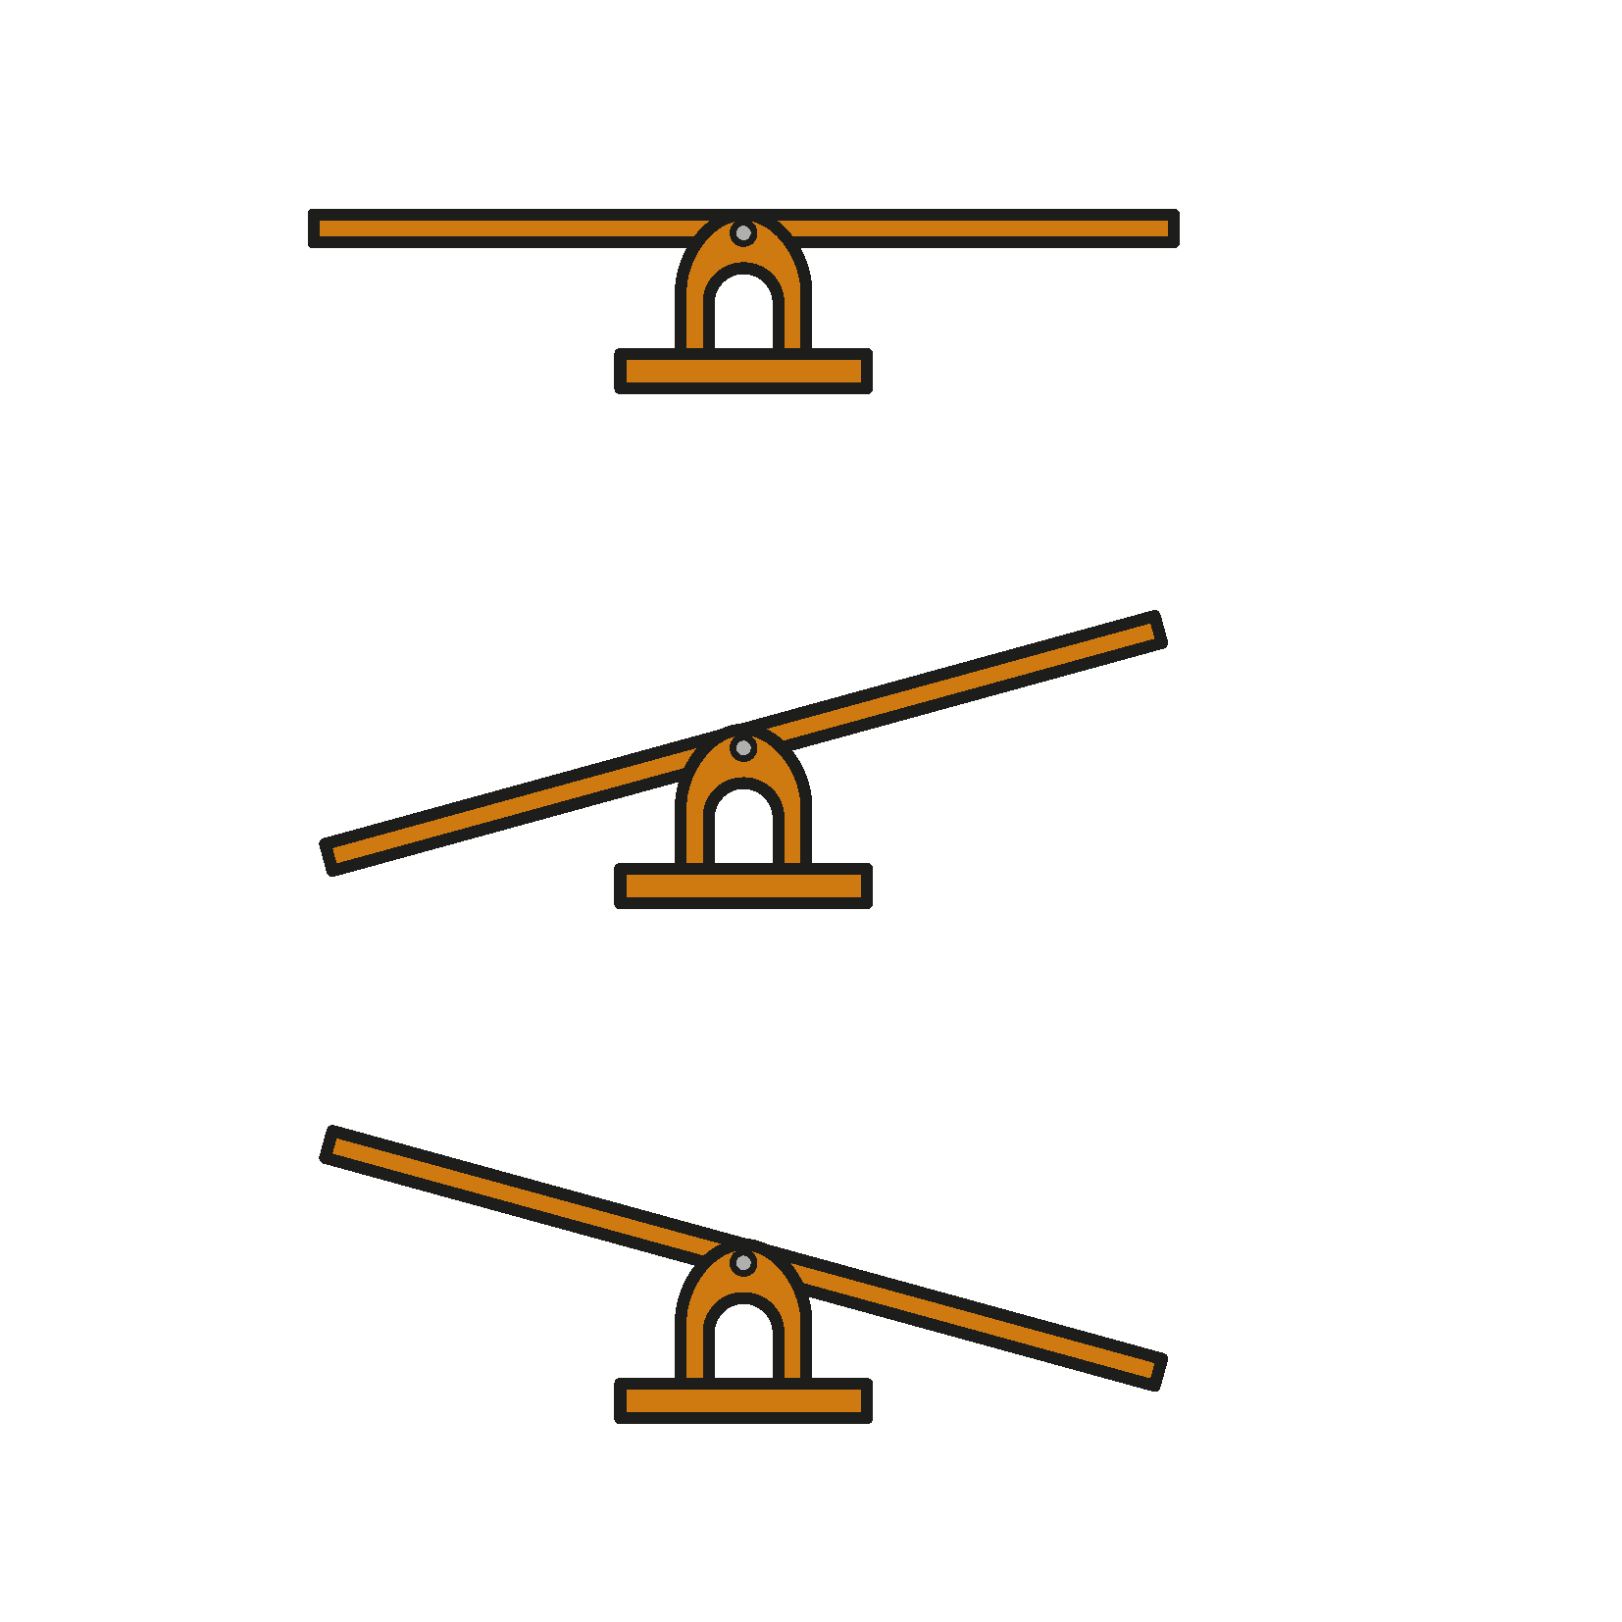


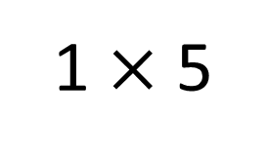
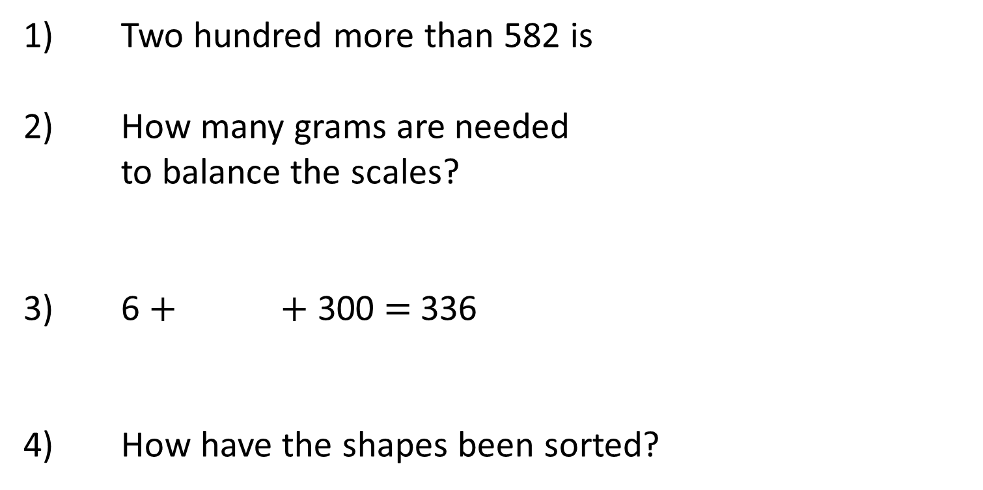
Year 3 | Week 5 | Day 1
1 $×$ 5
1) Two hundred more than 582 is
2) How many grams are needed
to balance the scales?
3) 6 $+$ $+$ 300 $=$ 336
4) How have the shapes been sorted?

Slide 12
Year 3 | Week 5 | Day 1
1 $×$ 5
1) Two hundred more than 582 is
2) How many grams are needed
to balance the scales?
3) 6 $+$ $+$ 300 $=$ 336
4) How have the shapes been sorted?
782
100 g
30
colour/ number of sides/ has curved sides

Slide 13
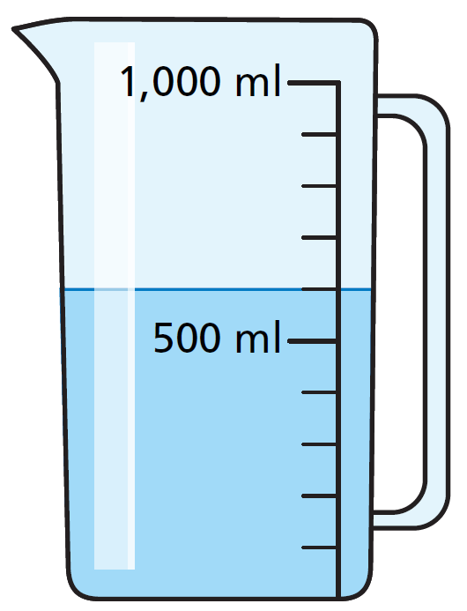
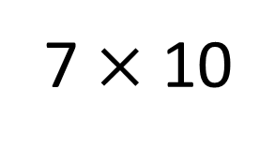
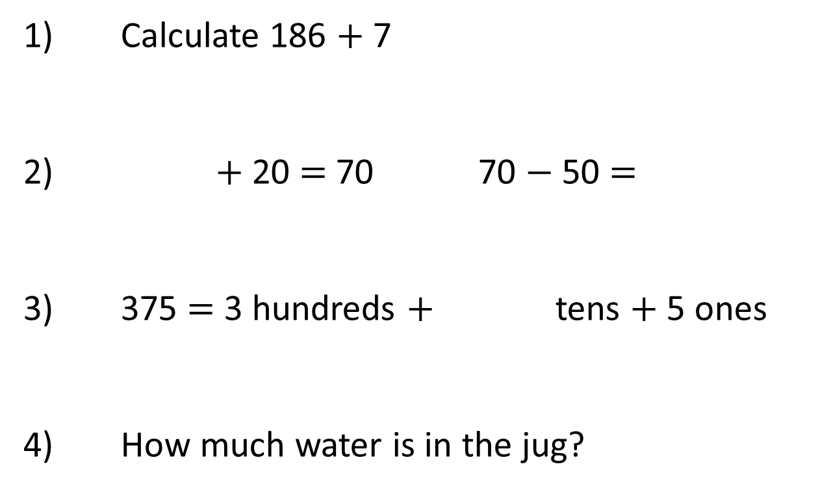
Year 3 | Week 5 | Day 2
7 $×$ 10
1) Calculate 186 $+$ 7
2) $+$ 20 $=$ 70 70 $−$ 50 $=$
3) 375 $=$ 3 hundreds $+$ tens $+$ 5 ones
4) How much water is in the jug?

Slide 14
Year 3 | Week 5 | Day 2
7 $×$ 10
1) Calculate 186 $+$ 7
2) $+$ 20 $=$ 70 70 $−$ 50 $=$
3) 375 $=$ 3 hundreds $+$ tens $+$ 5 ones
4) How much water is in the jug?
193
50
20
7
600 millilitres

Slide 15

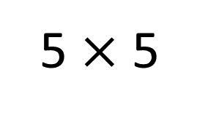
Year 3 | Week 5 | Day 3
5 $×$ 5
1) Complete the number track.
2) Add 3 ones to five hundred and forty-six.
3) How many tens are there in two hundred?
4) What is the mathematical name of this shape?
768 |  | 788 | 798 |  | 818

Slide 16
Year 3 | Week 5 | Day 3
5 $×$ 5
1) Complete the number track.
2) Add 3 ones to five hundred and forty-six.
3) How many tens are there in two hundred?
4) What is the mathematical name of this shape?
768 |  | 788 | 798 |  | 818
778
808
five hundred and forty-nine or 549
20
sphere

Slide 17
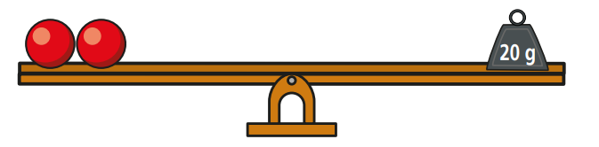
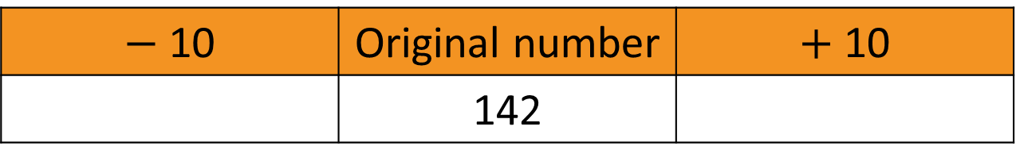
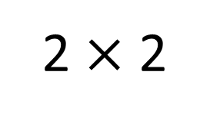
Year 3 | Week 5 | Day 4
2 $×$ 2
1) Subtract 8 from 125
2) Complete the table.
3) Add 300, 400 and 200 together.
4) What is the mass of 1 sphere?
$−$10 | Original number | $+$ 10
 | 142

Slide 18
Year 3 | Week 5 | Day 4
2 $×$ 2
1) Subtract 8 from 125
2) Complete the table.
3) Add 300, 400 and 200 together.
4) What is the mass of 1 sphere?
117
$−$10 | Original number | $+$ 10
 | 142
132
152
900
10 g

Slide 19
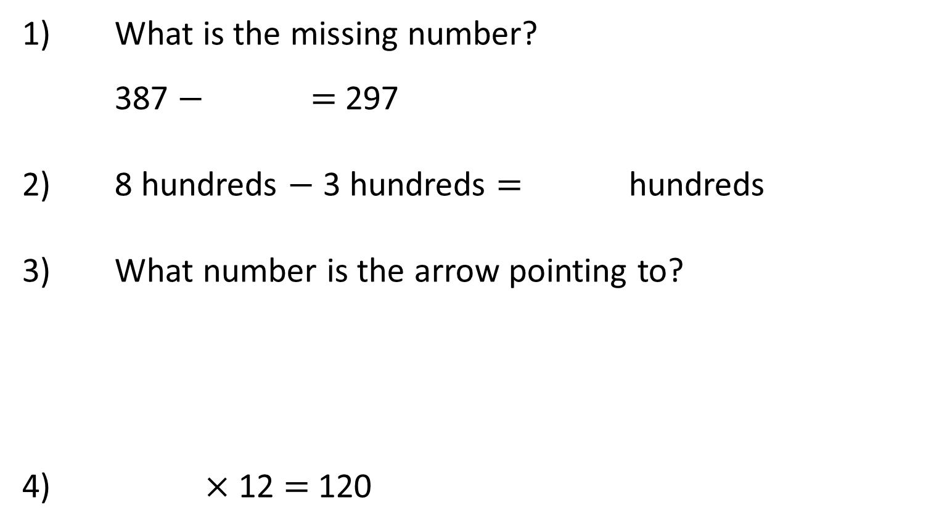
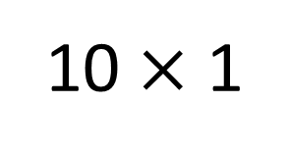
Year 3 | Week 5 | Day 5
10 $×$ 1
1) What is the missing number?
387 $−$ $=$ 297
2) 8 hundreds $−$ 3 hundreds $=$ hundreds
3) What number is the arrow pointing to?
4) $×$ 12 $=$ 120
0
200

Slide 20
Year 3 | Week 5 | Day 5
10 $×$ 1
1) What is the missing number?
387 $−$ $=$ 297
2) 8 hundreds $−$ 3 hundreds $=$ hundreds
3) What number is the arrow pointing to?
4) $×$ 12 $=$ 120
90
5
150
0
200
10

Slide 21
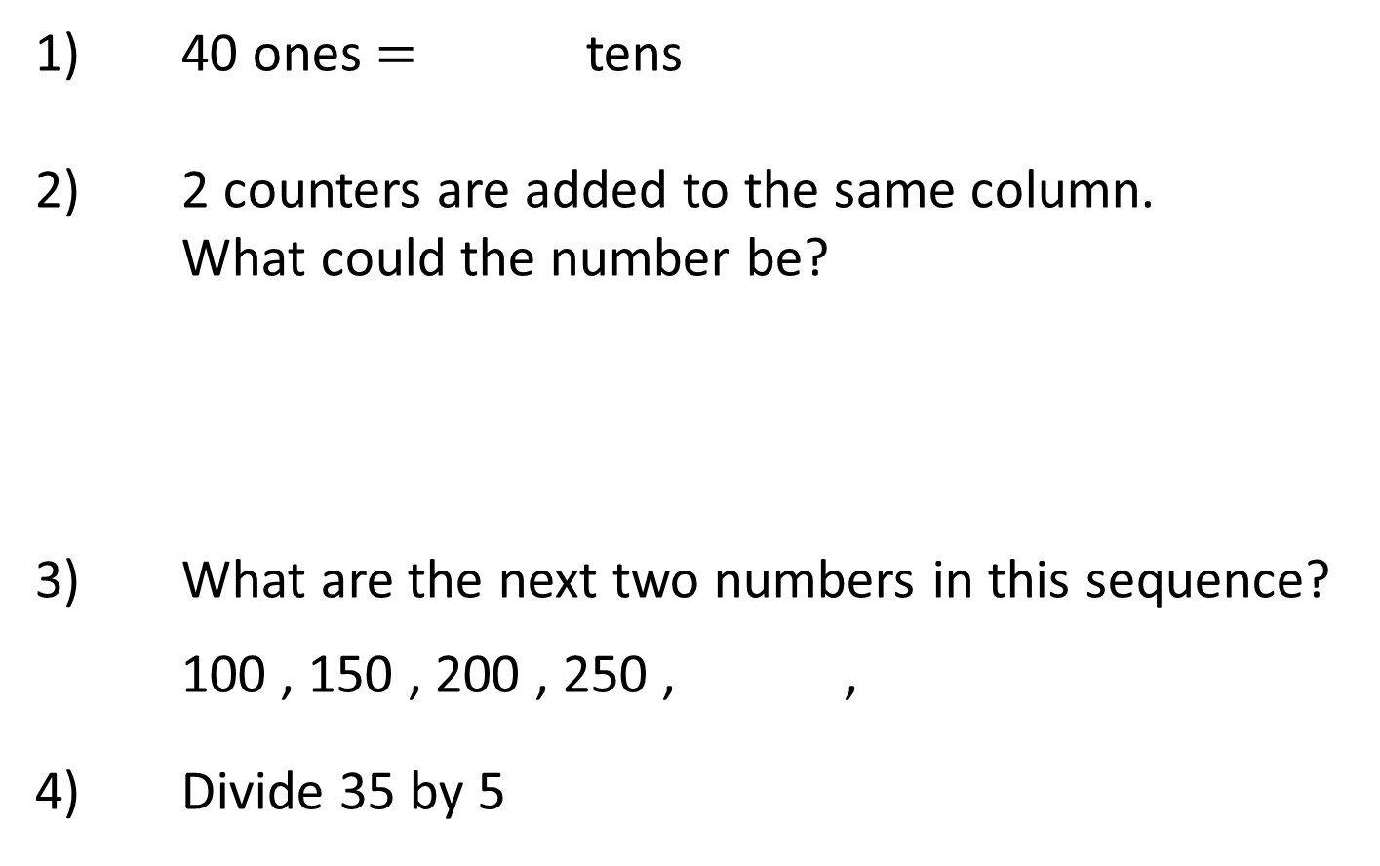
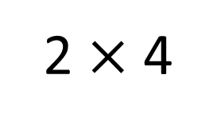
Year 3 | Week 6 | Day 1
2 $×$ 4
1) 40 ones $=$ tens
2) 2 counters are added to the same column.
What could the number be?
3) What are the next two numbers in this sequence?
100 , 150 , 200 , 250 , ,
4) Divide 35 by 5
Hundreds | Tens | Ones

Slide 22
Year 3 | Week 6 | Day 1
2 $×$ 4
1) 40 ones $=$ tens
2) 2 counters are added to the same column.
What could the number be?
3) What are the next two numbers in this sequence?
100 , 150 , 200 , 250 , ,
4) Divide 35 by 5
4
Hundreds | Tens | Ones
623
443
425
300
350
7

Slide 23
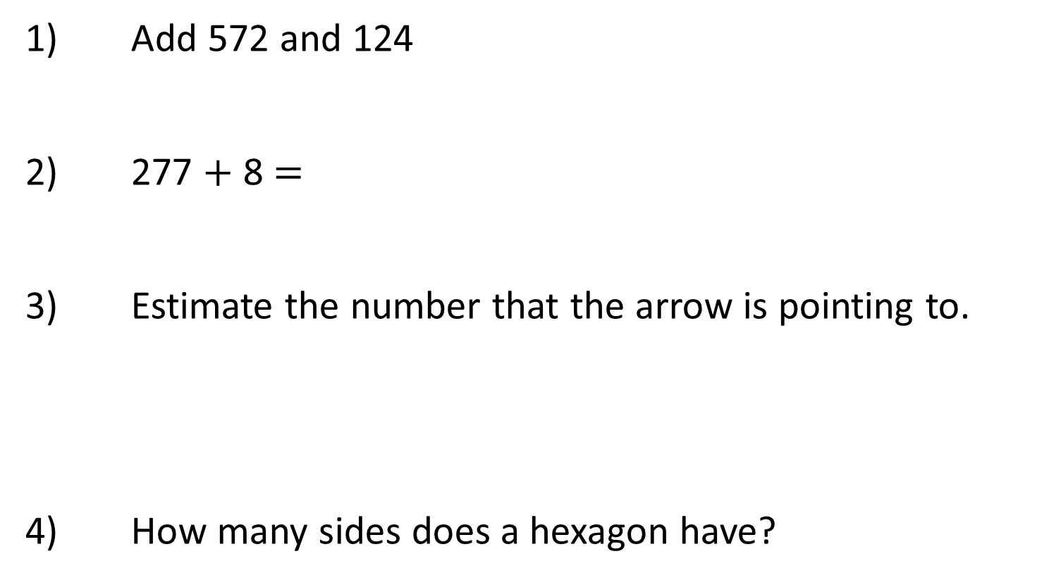
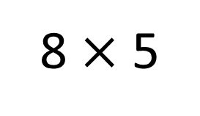
Year 3 | Week 6 | Day 2
8 $×$ 5
1) Add 572 and 124
2) 277 $+$ 8 $=$
3) Estimate the number that the arrow is pointing to.
4) How many sides does a hexagon have?
0
1,000

Slide 24
Year 3 | Week 6 | Day 2
8 $×$ 5
1) Add 572 and 124
2) 277 $+$ 8 $=$
3) Estimate the number that the arrow is pointing to.
4) How many sides does a hexagon have?
696
285
750
0
1,000
6

Slide 25
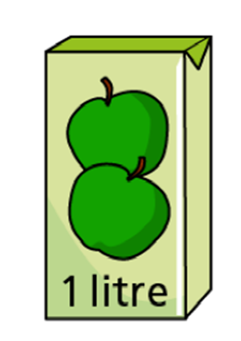
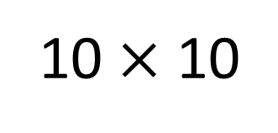
Year 3 | Week 6 | Day 3
10 $×$ 10
1) What is the difference between 853 and 302?
2) Whitney ran 262 metres on Saturday.
On Sunday, she runs 80 metres further than Saturday. How far does she run on Sunday?
3) What is 100 more than 85?
4) How much apple juice is there altogether?

Slide 26
Year 3 | Week 6 | Day 3
10 $×$ 10
1) What is the difference between 853 and 302?
2) Whitney ran 262 metres on Saturday.
On Sunday, she runs 80 metres further than Saturday. How far does she run on Sunday?
3) What is 100 more than 85?
4) How much apple juice is there altogether?
551
342 m
185
4 litres

Slide 27
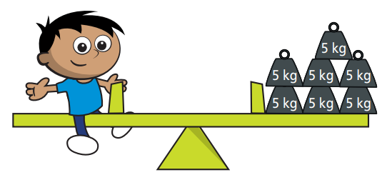
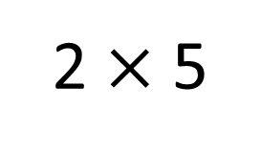
Year 3 | Week 6 | Day 4
2 $×$ 5
1) Find the sum of 225 and 316
2) Subtract 6 from 372
3) Order the numbers from smallest to greatest.
392 , 329 , 293 , 493
4) What is the mass of Amir?

Slide 28
Year 3 | Week 6 | Day 4
2 $×$ 5
1) Find the sum of 225 and 316
2) Subtract 6 from 372
3) Order the numbers from smallest to greatest.
392 , 329 , 293 , 493
4) What is the mass of Amir?
541
366
293 , 329 , 392 , 493
35 kg

Slide 29
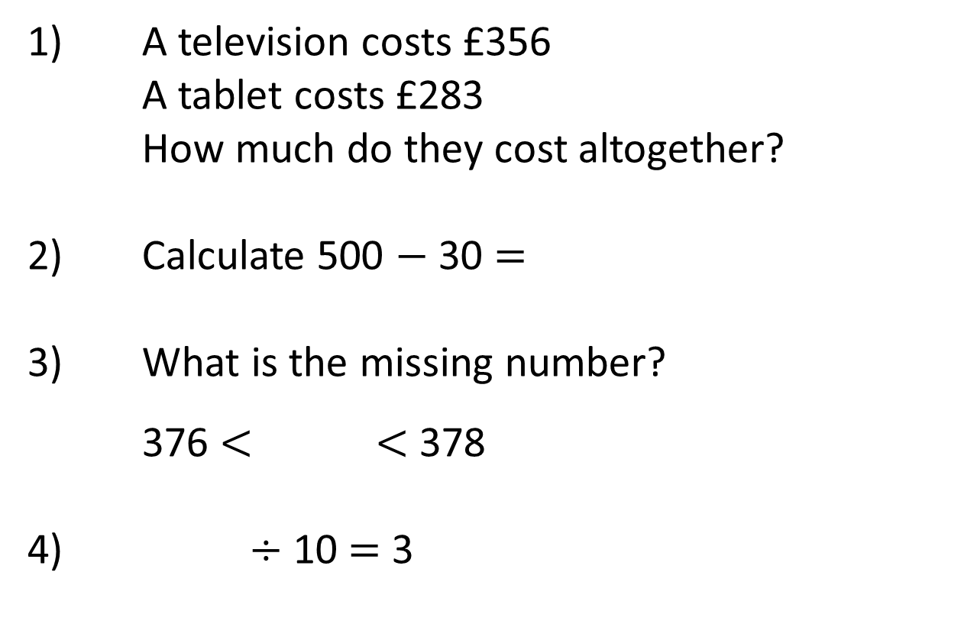
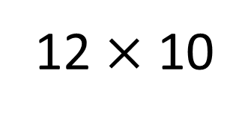
Year 3 | Week 6 | Day 5
12 $×$ 10
1) A television costs £356
A tablet costs £283
How much do they cost altogether?
2) Calculate 500 $−$ 30 $=$
3) What is the missing number?
376 $<$ $<$ 378
4) $÷$ 10 $=$ 3

Slide 30
Year 3 | Week 6 | Day 5
12 $×$ 10
1) A television costs £356
A tablet costs £283
How much do they cost altogether?
2) Calculate 500 $−$ 30 $=$
3) What is the missing number?
376 $<$ $<$ 378
4) $÷$ 10 $=$ 3
£639
470
377
30

Slide 31

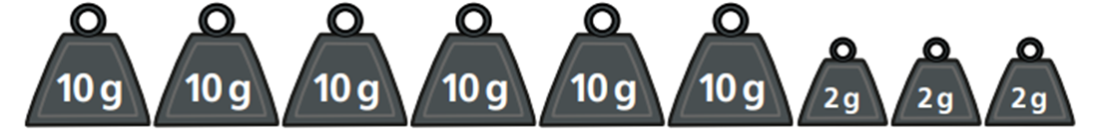
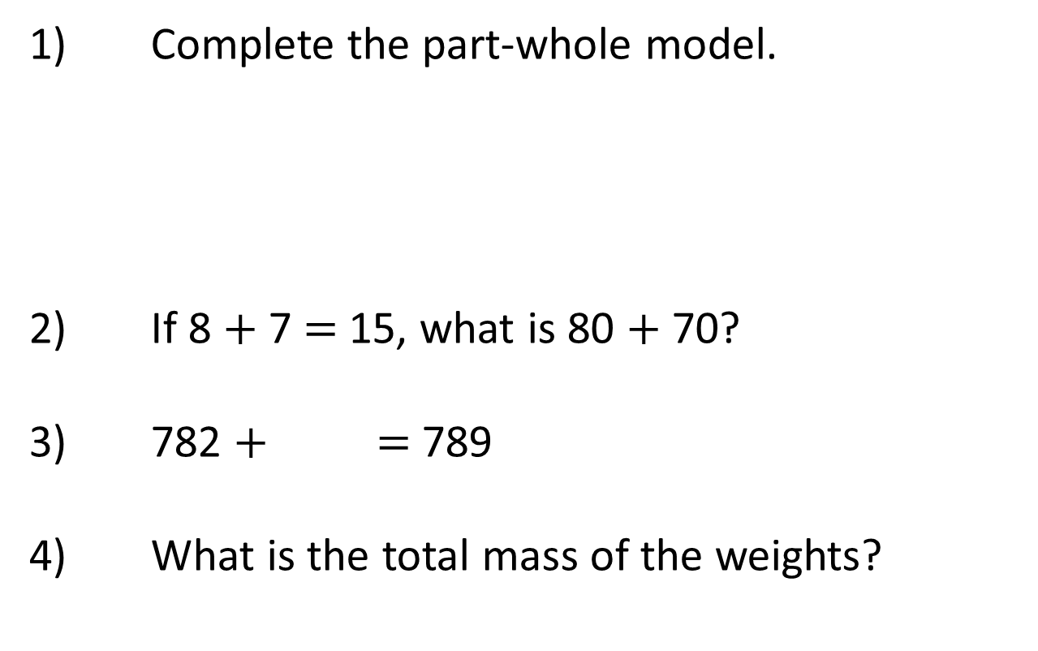
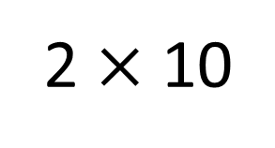
Year 3 | Week 7 | Day 1
2 $×$ 10
1) Complete the part-whole model.
2) If 8 $+$ 7 $=$ 15, what is 80 $+$ 70?
3) 782 $+$ $=$ 789
4) What is the total mass of the weights?
594
261

Slide 32
Year 3 | Week 7 | Day 1
2 $×$ 10
1) Complete the part-whole model.
2) If 8 $+$ 7 $=$ 15, what is 80 $+$ 70?
3) 782 $+$ $=$ 789
4) What is the total mass of the weights?
855
594
261
150
7
66 g

Slide 33

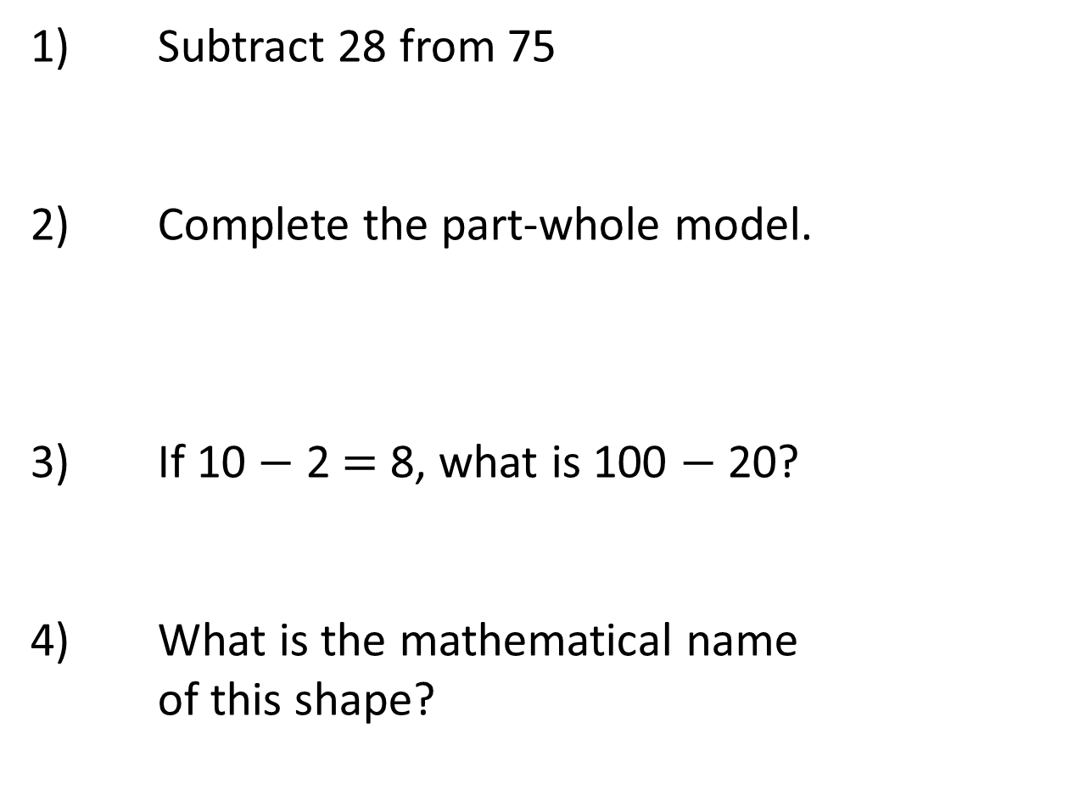
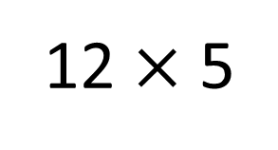
Year 3 | Week 7 | Day 2
12 $×$ 5
1) Subtract 28 from 75
2) Complete the part-whole model.
3) If 10 $−$ 2 $=$ 8, what is 100 $−$ 20?
4) What is the mathematical name
of this shape?
73
16

Slide 34
Year 3 | Week 7 | Day 2
12 $×$ 5
1) Subtract 28 from 75
2) Complete the part-whole model.
3) If 10 $−$ 2 $=$ 8, what is 100 $−$ 20?
4) What is the mathematical name
of this shape?
47
89
73
16
80
triangular prism

Slide 35
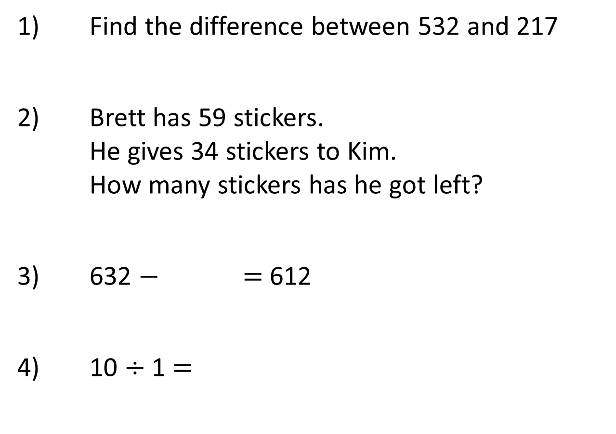
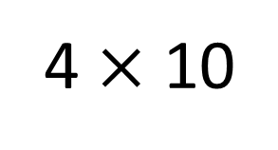
Year 3 | Week 7 | Day 3
4 $×$ 10
1) Find the difference between 532 and 217
2) Brett has 59 stickers.
He gives 34 stickers to Kim.
How many stickers has he got left?
3) 632 $−$ $=$ 612
4) 10 $÷$ 1 $=$

Slide 36
Year 3 | Week 7 | Day 3
4 $×$ 10
1) Find the difference between 532 and 217
2) Brett has 59 stickers.
He gives 34 stickers to Kim.
How many stickers has he got left?
3) 632 $−$ $=$ 612
4) 10 $÷$ 1 $=$
315
25
20
10

Slide 37

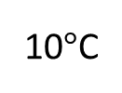
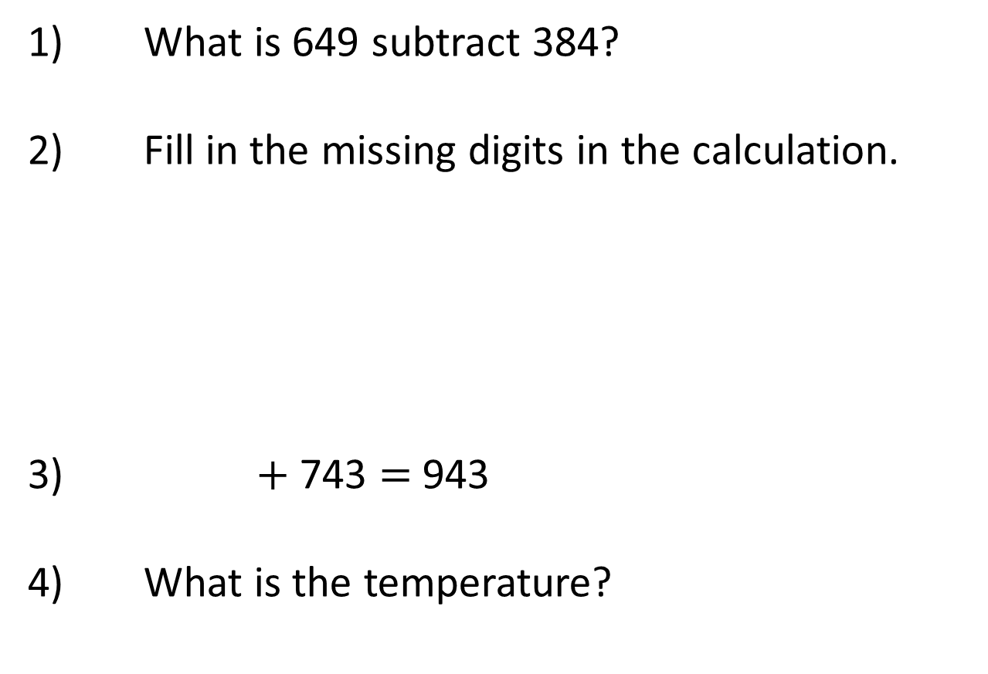
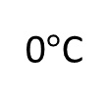
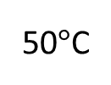
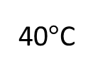
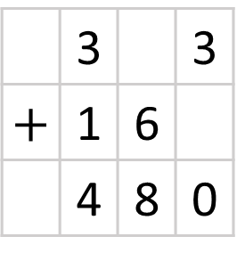
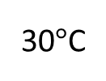
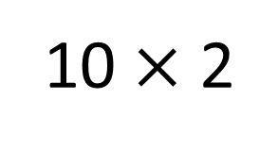
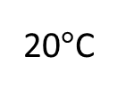
Year 3 | Week 7 | Day 4
10 $×$ 2
1) What is 649 subtract 384?
2) Fill in the missing digits in the calculation.
3) $+$ 743 $=$ 943
4) What is the temperature?
 | 3 |  | 3
$$+$$ | 1 | 6
 | 4 | 8 | 0
0$°$C
10$°$C
20$°$C
30$°$C
40$°$C
50$°$C

Slide 38
Year 3 | Week 7 | Day 4
10 $×$ 2
1) What is 649 subtract 384?
2) Fill in the missing digits in the calculation.
3) $+$ 743 $=$ 943
4) What is the temperature?
265
 | 3 |  | 3
$$+$$ | 1 | 6
 | 4 | 8 | 0
1
7
1
0$°$C
10$°$C
20$°$C
30$°$C
40$°$C
50$°$C
200
5°C

Slide 39



Year 3 | Week 7 | Day 5
5 $×$ 10
1) Amir jumps 118 cm.
Mo jumps 91 cm.
How far do they jump in total?
2) Complete the bar model.
3) Compare using $<$, $>$ or $=$
635 $−$ 30 635 $−$ 300
4) How many faces does the shape have?
638 | 193

Slide 40

Year 3 | Week 7 | Day 5
5 $×$ 10
1) Amir jumps 118 cm.
Mo jumps 91 cm.
How far do they jump in total?
2) Complete the bar model.
3) Compare using $<$, $>$ or $=$
635 $−$ 30 635 $−$ 300
4) How many faces does the shape have?
209 cm
831
638 | 193
$$>$$
5

Slide 41



Year 3 | Week 8 | Day 1
7 $×$ 2
1) Calculate 430 $+$ 87
2) Add 648 and 251 together.
3) What is 87 $+$ 3?
4) What is the mass of the orange?

Slide 42
Year 3 | Week 8 | Day 1
7 $×$ 2
1) Calculate 430 $+$ 87
2) Add 648 and 251 together.
3) What is 87 $+$ 3?
4) What is the mass of the orange?
517
899
90
70 g

Slide 43

Year 3 | Week 8 | Day 2
5 $×$ 9
1) Subtract 57 from 204
2) What is the missing digit?
3) What are the next two numbers in this sequence?
178 , 188 , 198 , ,
4) How many sides does a hexagon have?
 | 5 | 1 | 8
$−$ | 3 | 2 | 3
 | 1 |  | 5

Slide 44
Year 3 | Week 8 | Day 2
5 $×$ 9
1) Subtract 57 from 204
2) What is the missing digit?
3) What are the next two numbers in this sequence?
178 , 188 , 198 , ,
4) How many sides does a hexagon have?
147
4
1
 | 5 | 1 | 8
$−$ | 3 | 2 | 3
 | 1 |  | 5
9
208
218
6

Slide 45


Year 3 | Week 8 | Day 3
11 $×$ 10
1) 38 $+$ $=$ 100
2) Dora scores 162 points in a game.
Ron scores 38 less than Dora.
How many points does Ron score?
3) What is 265 $−$ 8?
4) 20 $÷$ $=$ 10

Slide 46
Year 3 | Week 8 | Day 3
11 $×$ 10
1) 38 $+$ $=$ 100
2) Dora scores 162 points in a game.
Ron scores 38 less than Dora.
How many points does Ron score?
3) What is 265 $−$ 8?
4) 20 $÷$ $=$ 10
62
124
257
2

Slide 47








Year 3 | Week 8 | Day 4
12 $×$ 2
1) Which is an incorrect estimate of 162 $+$ 411?
100 $+$ 400 160 $+$ 410 200 $+$ 400
2) What is 825 subtract 376?
3) 632 $−$ $=$ 582
4) What is the temperature?
0$°$C
10$°$C
20$°$C
30$°$C
40$°$C
50$°$C

Slide 48
Year 3 | Week 8 | Day 4
12 $×$ 2
1) Which is an incorrect estimate of 162 $+$ 411?
100 $+$ 400 160 $+$ 410 200 $+$ 400
2) What is 825 subtract 376?
3) 632 $−$ $=$ 582
4) What is the temperature?
449
50
0$°$C
10$°$C
20$°$C
30$°$C
40$°$C
50$°$C
45°C

Slide 49

Year 3 | Week 8 | Day 5
5 $×$ 5
527
345 | 182
1) Use the bar model to
complete the subtractions.
$−$ $=$ $−$ $=$
2) Eva saves £212 and Mo saves £96
How much have they saved in total?
3) 60 tens $=$ hundreds
4) How many faces does a cube have?

Slide 50
Year 3 | Week 8 | Day 5
5 $×$ 5
527
345 | 182
1) Use the bar model to
complete the subtractions.
$−$ $=$ $−$ $=$
2) Eva saves £212 and Mo saves £96
How much have they saved in total?
3) 60 tens $=$ hundreds
4) How many faces does a cube have?
527
345
182
527
182
345
£308
6
6

