Slide 1

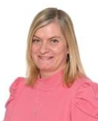

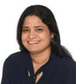
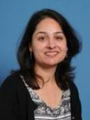
Welcome to Year 4
Triumph Class
Mrs Laker
Miss Padezanin
LSA
Mrs Kugan
LSA
Ms Shah
TA

Slide 2
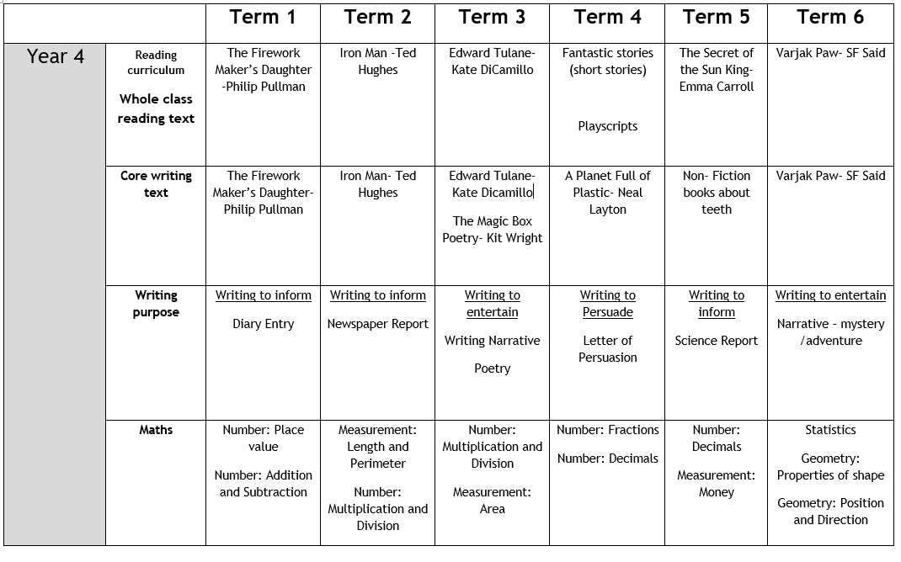

Slide 3
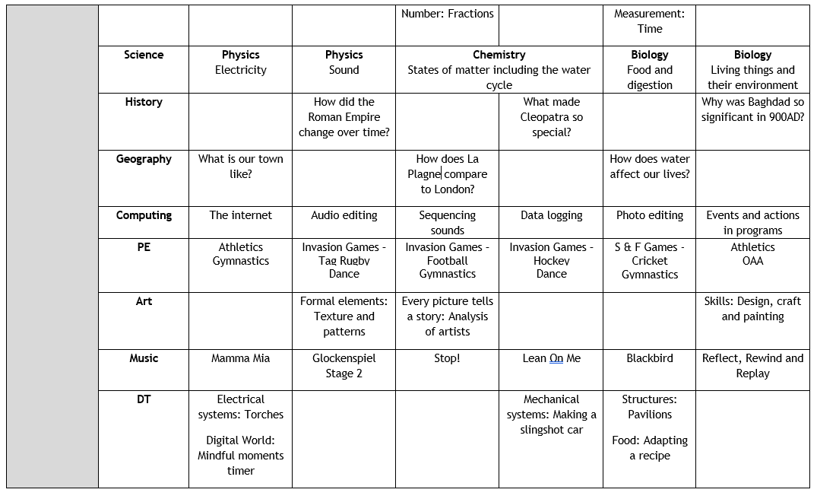

Slide 4
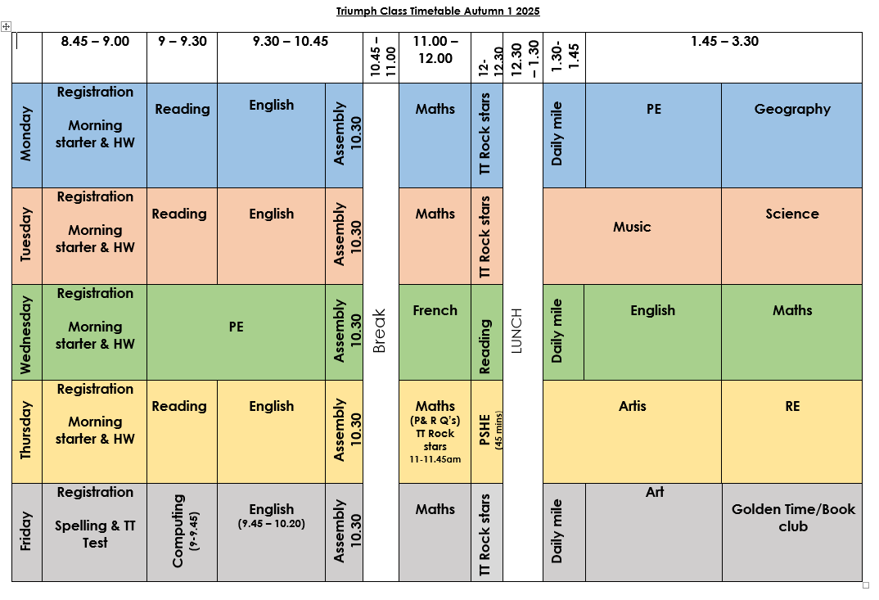
Timetable

Slide 5
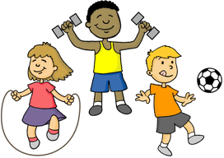

PE
Children can wear their PE kits for the whole day on Monday & Wednesday. However, they must come to and from school in their jumper or cardigan, showing their school logo.
Artis (drama) is on Thursday.

Slide 6
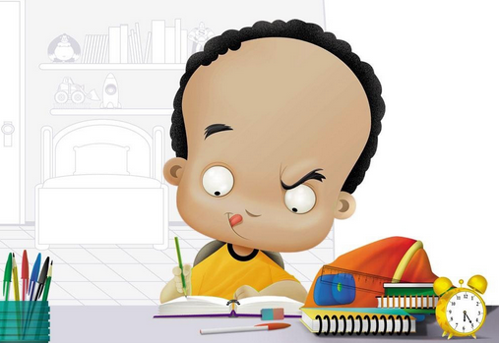
Homework
Homework is given to the children on a Friday and is to be returned on Wednesday.
It is linked to the children’s learning that week.
Spellings: Given out on Friday. Tested on the following Friday.
TT Rockstars and other Time Table games (links available on class page) are to be practised at home daily.
Children will have a timed Times table test on a Friday

Slide 7
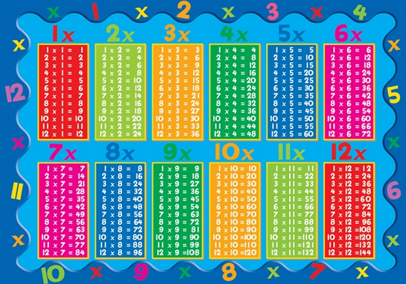
Extra support at home.
It would really support your child if you could also practise times tables as often as possible.
By the end of year 4, children should be able to instantly recall their 2-12 times tables.
In June, all children will take the Multiplication Times table Check.

Slide 8

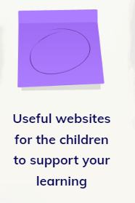



Extra support at home.
The class page on the school website has resources that the children can access to practice their times tables at home. Go to-
Merton Abbey Primary School
Children - then click on class pages
Y4-Triumph Class
Scroll down to useful websites to support your child’s learning or Multiplication Check resources

Slide 9
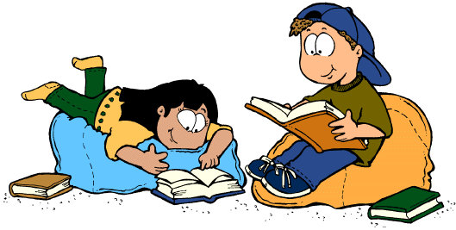
Reading
Children are expected to read each night. Please record the book title, page numbers read and a comment about your child’s reading.
Children should bring their reading records in daily.

Slide 10
Reading
We also have a book club which runs on a Friday afternoon.
We work in conjunction with Kings College and Harris Academy. The children have book leaders who support them with their reading and they carry out fun activities related to the texts they have read.
Children also get to visit Kings and meet the author of the book they have been reading.
Book club will continue until May 2026, therefore the children do not have Golden Time on a Friday afternoon.

Slide 11
PSHE
Autumn: Relationships
-friendships - respectful communications –dares and playful teasing – similarities and differences
We are introducing the digital Zones of regulation curriculum
Spring: Living in the wider world
-community – finance and budgeting – digital footprints
Summer: Health and Wellbeing
-staying healthy – looking after teeth – different parts of the body – puberty and how the body changes – how drugs affect our health.

Slide 12
Educational visits
Local library visit– Colliers Wood (Autumn term)
Local area walk about – Geography topic – Our Town (Autumn 1)
Author visit – King’s College School (Spring term)
Water treatment plant– Geography topic - How water affects our lives (Summer term)
Morden Hall Park – Science topic - Classifying Invertebrates (Summer Term – paid for trip)

Slide 13
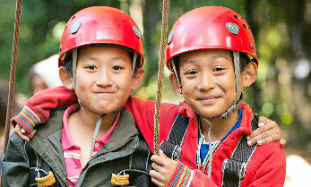
Educational visits
Residential trip – Summer term for year 3 & 4 pupils to the activity centre Kingswood.
Further details will be available soon from Mrs Eversden.

Slide 14

Any Questions?

Slide 15

Thank you for your support!
Mrs Laker & the
Year 4 team

